Slide 1

September 2025 – July 2026
PSHE and Citizenship Curriculum

Slide 2
Contents
Curriculum Intent | p3
Curriculum Implementation | p4
Right to Withdraw | p5
Curriculum Overview | p6

Slide 3
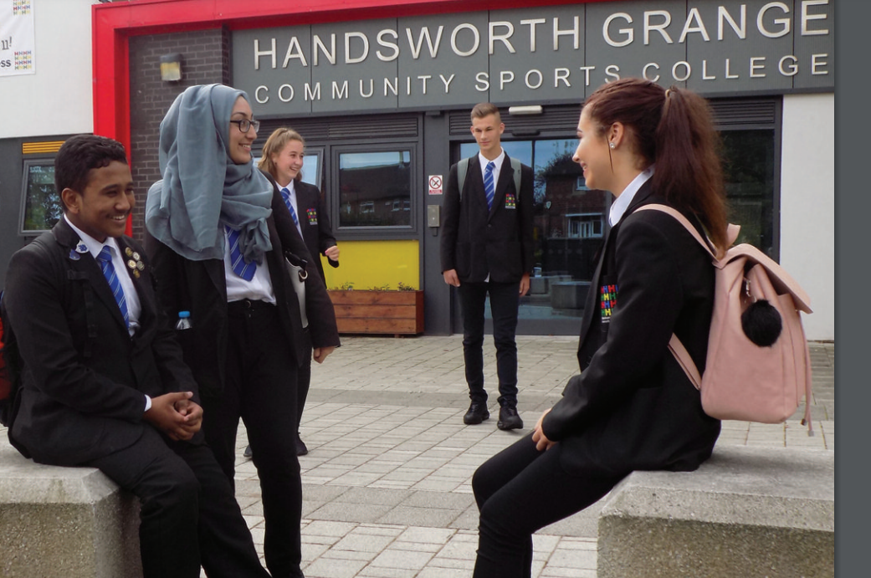
Curriculum Intent
Our PSHCE curriculum aims to provide all students with access to well-sequenced, high-quality lessons which are tailored to meets the needs of our diverse community.
The PSHCE curriculum focuses on four key strands:
Health and Wellbeing
Sex and relationships
Wider World including CEIAG (Careers Education, Information and Guidance)
Citizenship.
These themes are knowledge rich, engaging and afford students the opportunity to debate in a safe environment, with clear ground rules promoting respect and compassion.
Our intent is to allow students to reflect on and clarify their own values and attitudes as well as explore complex and sometimes conflicting range of values and attitudes they might encounter now and in the future.
We encourage our students to be enterprising and support them in making effective transitions, informed decisions, positive learning and career choices and in achieving economic wellbeing. In addition, we seek to ensure all students have the knowledge, skills and attributes to keep themselves healthy, safe and prepared for life and work as a citizen in modern Britain.
In essence, PSHCE aims to empower our students with the ability to make good choices, report concerns with confidence and lead happy, successful lives.

Slide 4
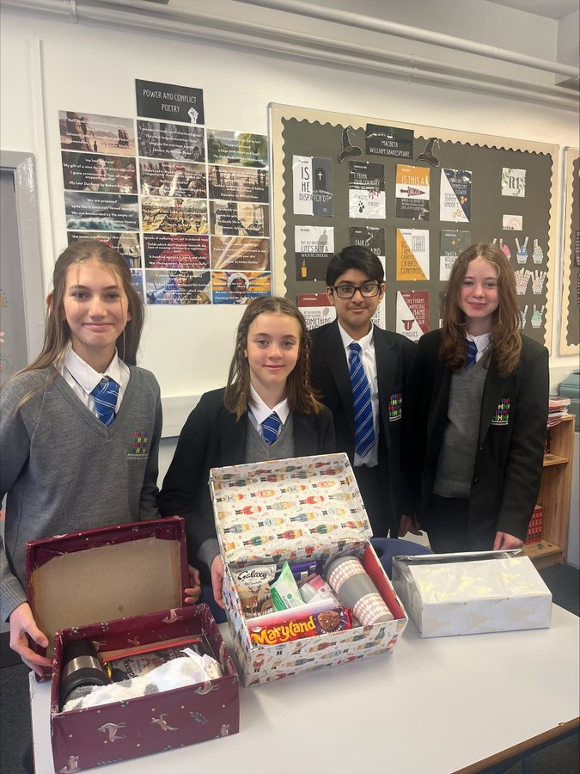

Curriculum Implementation
PSHCE (Personal, Social, Heath, Citizenship and Economic education) is taught within the umbrella of Personal Development and compliments the wider programme of assemblies, tutor group activities, enrichment opportunities, character education and drop-down events.
Handsworth Grange prioritise PSHCE and ensure parity with other academic subjects by providing dedicated timetabled lessons to allow sufficient time for discussion and reflection.
  At KS3, all students have 1 lesson of PSHCE every week
  At KS4, all students have 1 lesson of PSHCE every week shared with RS.
PSHCE lessons are delivered using booklets which are regularly reviewed to ensure they are age-appropriate and responsive to emerging trends in school, locally and nationally.
Student knowledge is regularly assessed and used to inform future planning. Student views are also sought to ensure the PSHCE curriculum reflects their needs and is responsive to challenges they might face.

Slide 5
Right to Withdraw
Parents have the right to request that their child be withdrawn from some or all of sex education delivered as part of statutory RSE. Sex education is delivered in:
    Year 9 Spring 1 Intimate Relationships
    Year 10 Autumn 1 Healthy Relationships
    Year 11 Spring 2 Relationships and families
If you wish to withdraw your child from some or all sex education lessons, we would urge you in the first instance to discuss this with the school directly. You are welcome to view resources, ask questions about topics covered and discuss anything else that might be a concern. We understand that this can be a sensitive topic but often a chance to talk through concerns can help to allay any worries you may have. Lessons are delivered in a professional, inclusive and sensitive manner with the aim to educate students so they can make informed decisions and stay safe. If you wish to withdraw your child you should contact: Mr Wright on bwright@handsworth-mlt.co.uk
Please be aware that parents have no right to request their child be withdrawn from lessons on relationships or health education which are statutory.
Up to and until three terms before the child turns 16, a parent retains the right to request withdrawal from sex education. After that point, if a child wishes to receive sex education rather than be withdrawn, the school will make arrangements to provide the child with sex education during one of those terms.

Slide 6
PSHCE Curriculum Map 2025-2026
 | HT1 | HT2 | HT3 | HT4 | HT5 | HT6
Y7 | Managing change & staying safe Managing emotions moving to secondary school and how to overcome challenges posed by change. Students reflect on good qualities in new friends and how to form new relationships. As some students may be walking to school or using the bus for the first time, it is appropriate to revisit road safety awareness from Year 6. With increased independence and new friends, students may find themselves in the community more and so personal safety on rail, roads and water has also been included. | Puberty and personal safety The average ages for puberty starting is 11 for girls and 12 for boys*, which suggests this needs to be addressed early in Year 7. Students learn about healthy routines around personal hygiene as well as physical/emotional changes in puberty. As students learn key features of genitalia as part of puberty, FGM, is also taught at the end of this unit to raise awareness. FGM is carried out between infancy and 15 years, most commonly before puberty starts and so this supports sequencing this subtopic here. | Digital safety Ofcom's 2022 research into technology use across the UK showed that nearly all 13 – 15 year olds (98%) have their own phone. For most of these young people, they were given their phones around the start of secondary school, between the ages of 9 and 11 (91%). Feedback from students also suggests that many are accessing gaming sites where they are exposed to potential risks of bullying and/or grooming. Students need to be aware of the impact of posting rude or discriminatory comments online. Students are taught to identify concerns as well as how to report them. Students also explore the rise of fake news and AI. | Drugs and Alcohol vaping and smoking, also adding knowledge around energy drinks, caffeine, alcohol and prescription drugs. These topics have been prioritised due to the rise nationally in young people vaping. New figures from NHS Digital show a decrease in numbers of school children taking drugs and smoking cigarettes but a rise in vaping, with 9% of 11 to 15 year olds currently using e-cigarettes*. | Self-awareness This topic introduces students to the term 'Labour Market Information’. It explores the concept of employment, 'job' and 'career’. Subtopics focused on skills and qualities will ensure that students are familiar with language used within recruitment and employment, whilst appreciating the importance of evidencing their skills. This is the foundation for successful applications later in school and begins to develop a sense of self awareness. Focusing on a specific skill such as teamwork will help to consolidate students understanding of being positive, behaving appropriately, being timely, reliability and responsibility. Students will also learn the value of enterprise and money management. | Diversity and equality These subtopics build on students' knowledge of protected characteristics that is taught throughout the PSHE curriculum. These subtopics look at the Equality Act 2010 in greater detail and how it prevents discrimination and prejudice in modern Britain. Students will learn key words such as diversity, equality and stereotypes. Subtopic 3 will also link to the wider CEIAG programme by looking at workplace examples of stereotyping to combat these and broaden horizons. Students will be introduced to different bullying behaviours and know where to report issues as well as understanding the importance of calling bullying out.
Y8 | Citizenship This topic supports statutory Citizenship education. This topic provides students with knowledge, skills and understanding to prepare them to play a full and active part in British society. This topic seeks to foster students’ keen awareness and understanding of democracy, government and how laws are made and upheld. It helps to prepare students to take their place in society as responsible citizens. This unit is prior to work around financial literacy which links into this work and the theme of responsibility. | Identity & relationships This unit is focused on healthy relationships. Students are taught the facts about sexual orientation and gender identity in an age-appropriate and inclusive way. Students also explore the themes of sexism and misogyny This knowledge is built upon in Year 9 when students learn about different intimate relationships. There is equal opportunity to explore the features of all stable and healthy relationships. As RSE guidance states LGBT+ themes are fully integrated throughout the PSHCE programme, rather than addressed separately or in only one lesson. | Work and Money Budgeting, saving and borrowing and making financial choices. Bank accounts begin from age 11 and so if students have yet to open an account, this is a timely reminder of this option. It is students first exposure to financial literacy and is timed for when student may access their own funds more readily and therefore be exposed to online scams and will benefit from an understanding of budgeting etc. The unit revisits material from earlier in Year 7 which relates to staying safe online, mental wellbeing and reporting issues online. | Grooming and Exploitation Risky behaviours, gangs and knife crime. Knife crime remains a national priority with an increase of 6% in knife crime in England and Wales in 2022* This links to previous learning in Year 7 and Year 8 around the signs of healthy and unhealthy friendships. Students also learn about county lines as crime statistics show these activities are prevalent in south Yorkshire. CSE and radicalisation are also explored within the theme of exploitation. | Careers This topic highlights the skills and attributes that employers value as well as giving students opportunity to reflect on their own skills and attributes. It explores different types and patterns of work, including employment, self-employment and voluntary work; that everyone has a different pathway through life, education and work. Students will know how to create a good professional presence online. | Mental Health The unit builds on work around managing emotions that took place at the start of Year 7 on transition and emotions during puberty. This unit seeks to break down stigmas that exist around mental health and provide useful coping strategies to support students. The theme of digital resilience is also introduced and how time spent online can impact on wellbeing as well as fears around body image. This has been moved from Year 9 as concerns around body image are developing earlier with greater access to apps/filters etc.
Ethics and Morality | Health & Wellbeing | Relationships | Wider World Inc CEIAG | Citizenship

Slide 7
 | HT1 | HT2 | HT3 | HT4 | HT5 | HT6
Y9 | Drugs and health This builds on knowledge from Year 7, around substance use and substance abuse.​ Students are taught about the laws of illegal substance use. Lessons pay particular attention to those drugs that have been identified as more likely to be used by young people for example cannabis and nitrous oxide.​ The causes and effects pf addiction are also explored. | Healthy Relationship's Previous RSE lessons in Year 7 and Year 8 have focused on the characteristics of healthy relationships. In Year 9, students begin to reflect on different types of families and relationships that exist. This unit looks at legal rights of different relationships, how these relationships contribute to human happiness and successful parenting. More mature themes around conflict, coercion, sexual harassment and abuse are addressed in an age-appropriate way, focusing on safeguarding to ensure students know how and when to access support. | Intimate relationships Sex education has been sequenced at this point once students have a strong understanding of healthy relationships. The unit is focused on providing all students with the information they need to make informed choices relating to readiness for intimacy, different methods of contraception and information around sexual health. As pornography is so readily available, this is an appropriate point to address the impact this has on sexual relationships. In 2023, the Children’s Commissioner reported that pornography exposure is widespread and normalised – to the extent that children cannot ‘opt-out’. The average age at which children first see pornography is 13. | Opportunity awareness Students will learn about the post 16 options available to them and explore sources of information, advice and support to manage their GCSE options process. | Citizenship Students are introduced to the judicial process, through which courts resolve disputes, enforce laws and deliver justice. We also explore the roles the citizen can play within the criminal justice system and why this is fundamental to democracy. | Health Independence This topic highlights the importance of strategies for maintaining a work life balance. The benefits of physical activity and exercise for physical and mental health and wellbeing are explored along with the importance of sleep and strategies to maintain good quality sleep. The role of a balanced diet as part of a healthy lifestyle and the impact of unhealthy food choices, Influence on diet and strategies to manage eating choices are also covered. This topic will allow students to have increased responsibility for their own physical health including dental check-ups, sun safety and how to access appropriate health services.
Y10 | Healthy relationships This unit revisits knowledge from Year 9 around intimacy and shares more mature themes relating to sexual relationships. Students are encouraged to challenge peer pressure and assess their own readiness for intimacy. The role of pleasure addresses how intimate relationships must be consensual and the importance of seeking consent regularly with everyone having the right to withdraw this at anytime. Pornography is also revisited with reinforcement around unrealistic expectations and laws surrounding this. Mature themes such as persuasion, gaslighting and coercion are also taught with a focus on sexual harassment. | RE Matters of Life and Death This unit begins by examining moral decisions and how these differ from more everyday decisions. We examine why we make the decisions we do and to what extent these are impacted by consequence, by outcome or by background factors. By exploring natural moral law and situation ethics we assess approaches to moral decision making and how these might be applied in our own lives. | RE Matters of life and death Using these moral approaches, we examine the ehical issues of abortion, euthanasia, capital punishment and animal rights. Through a series of case studies and examples we establish religious views, socially common views and our own opinion as well as the thinking which underpins these decisions. | Health Independence This final topic on sexual health builds on knowledge from Year 9 and Year 10 on STIs. It considers the importance of looking after your health and the potential impact on your future. This links to knowledge around risky behaviours and healthy lifestyles. Subtopics also look at self-examination which is advised to take place at late secondary stage and fits effectively in this topic. The subtopic on self-examination and screening emphasises how important it is to check our bodies for abnormalities to support early identification of ill health. It aims to empower students to report concerns early to safeguard their health. | Wellbeing and online safety From the data available, around 2 million people in the UK are likely to be at risk of harm through gambling, with an additional 400,000 having developed a serious gambling disorder. This enables us to build on knowledge from Y8 on Financial Literacy. This topic addresses the theme of cybercrime which is one of the fastest rising crimes in the UK, and is particularly common amongst young people, with 61% of hackers beginning hacking before the age of 16, and with some becoming involved with illegal online activity as young as 12. The topic also addresses targeted advertising, buying illegal products and viewing harmful content. | Mental wellbeing As Year 10 embark on their GCSE studies, it is important to ensure they have the foundations needed to manage some of the challenges they might face. Initial lessons focus on recognising potential barriers and methods to overcome these effectively. Students will look at more serious mental health issues and dependency on alcohol/drugs as well as be signposted to support available. This topic will also support with change, loss and grief. Time is taken here to look at emotions surrounding this and to give students the power to know how to support themselves but also others such as friends, parents and family so they have the knowledge and skills needed to navigate difficult times.
Ethics and Morality | Health & Wellbeing | Relationships | Wider World Inc CEIAG | Citizenship

Slide 8
 | HT1 | HT2 | HT3 | HT4
Y11 | Building for the future The first topic of Year 11 provides students with a review of key themes around mental health. This is a timely reminder of managing time effectively between revision and other commitments, family and leisure time. Lesson time is dedicated to exploring different types of qualifications available post 16. | Building for the future continued Support is given to complete college application forms and to write personal statements. As many students begin to consider the prospect of a part time job as they near or turn 16, it is an appropriate time to encourage this to begin after GCSE’s and support of producing a professional CV is also given. | RE matters of life and death This unit begins by examining moral decisions and how these differ from more everyday decisions. We examine why we make the decisions we do and to what extent these are impacted by consequence, by outcome or by background factors. By exploring natural moral law and situation ethics we assess approaches to moral decision making and how these might be applied in our own lives. Using these moral approaches, we examine the ethical issues of abortion and euthanasia. Through a series of case studies and examples we establish religious views, socially common views and our own opinion as well as the thinking which underpins these decisions. | Relationships and families This topic revisits subtopics of forced marriage and FGM, previously taught in KS3 to review understanding around these important safeguarding issues. Students will also look in more detail at theses around women's health such as pregnancy and health during pregnancy, periods and endometriosis. Parental responsibility will also be covered and the concept of children within marriage will be explored.
Ethics and Morality | Health & Wellbeing | Relationships | Wider World Inc CEIAG | Citizenship

